Slide 1

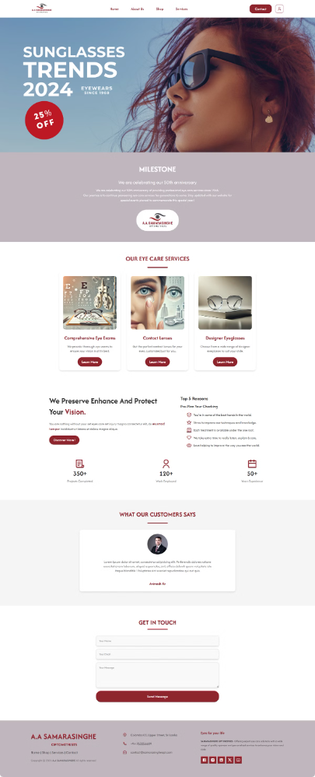
Samarasinghe Optical Website Upgrade
This project outlines the upgrade and enhancement of the existing web application for Samarasinghe Optical to include an online store. The upgraded web application will enable customers to browse products, place orders, and make payments online, facilitating a seamless shopping experience from anywhere in the world.

Slide 2
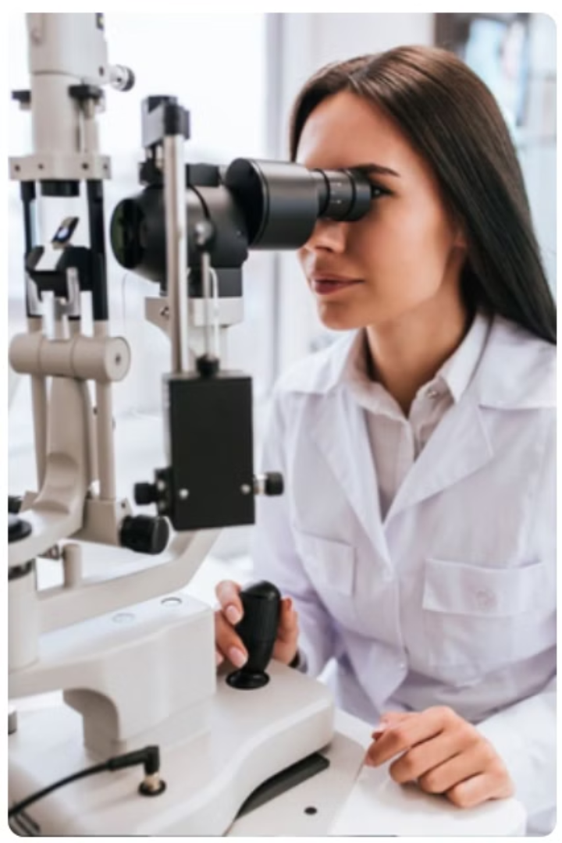
Problem Statement
Shift to Online Shopping
The pandemic has accelerated the shift towards online shopping, impacting traditional retail businesses.
Challenges for Businesses
Businesses without online presence face challenges like reduced foot traffic, decreased sales, and limited customer engagement.
Proposed Solution
Upgrading Samarasinghe Optical's website with an integrated e-commerce solution will address these challenges.

Slide 3
Literature Review
Vision Care Online Store
Wickramarachchi Opticians
Offers customers the convenience of browsing and purchasing eyewear products directly through their website.
Provides a comprehensive platform for customers to purchase optical products, such as eyeglasses, sunglasses, hearing aids, and contact lenses.
User-friendly product browsing and search functionality
Intuitive product catalog and search functionality
Secure online payments
Secure online payments
Product filtering by categories
Product categories including eyeglasses, sunglasses, contact lenses, and hearing aids
Customer account management
Mobile responsiveness
Order customization and prescription upload options
Mobile-friendly design

Slide 4

Project Objectives
1
User-Friendly Interface
2
Effective Communication
Design and develop a user-friendly interface for the online store.
Enable effective communication between the business and customers through contact forms and customer support features.
3
Detailed Product Listings
4
Order Tracking and Account Management
Provide detailed product listings and descriptions, along with reporting tools for sales and customer behavior.
Implement order tracking and customer account management.

Slide 5
Agile Development Methodology
1
Rapid Adaptation to Change
Agile allows the team to quickly adapt to changes in customer needs, technology, and market conditions.
2
Reduced Risk
Regular iterations and feedback loops help mitigate risks by addressing issues early in the development cycle.
3
Improved Team Collaboration
Agile promotes close collaboration among team members, ensuring better communication and alignment with project goals.
4
Higher Quality Products
Through continuous testing and frequent releases, Agile helps ensure a high-quality product with fewer defects.

Slide 6

Technical Feasibility
Existing Infrastructure
Sufficient computer systems and a high-speed internet connection.
Technology Requirements
Visual Studio Code, XAMPP for the web server, and standard web browsers.
Team
Project team consists of 5 members with expertise in web development.

Slide 7
Economic Feasibility
Estimated Development Cost
LKR 120,000
Estimated Maintenance Cost
LKR 30,000
Estimated Revenue
LKR 190,000
Return on Investment (ROI)
33.33%
Payback Period
0.75 years

Slide 8



Operational Feasibility
Training for Staff
Training for staff to manage the online store and handle customer inquiries.
User Manual and Support Documentation
A user manual and support documentation to assist with daily operations.
Contingency Plans
Contingency plans to address any potential technical issues or disruptions.

Slide 9




Risk Analysis
Technical Obstacles
Timeline Constraints
Unforeseen technical issues during development could delay the project.
Delays in project milestones could push back the launch of the online store.
Data Security Breaches
Scalability Challenges
Customer data and payment information could be vulnerable to security breaches.
The website may struggle to handle increased traffic as the business grows.

Slide 10
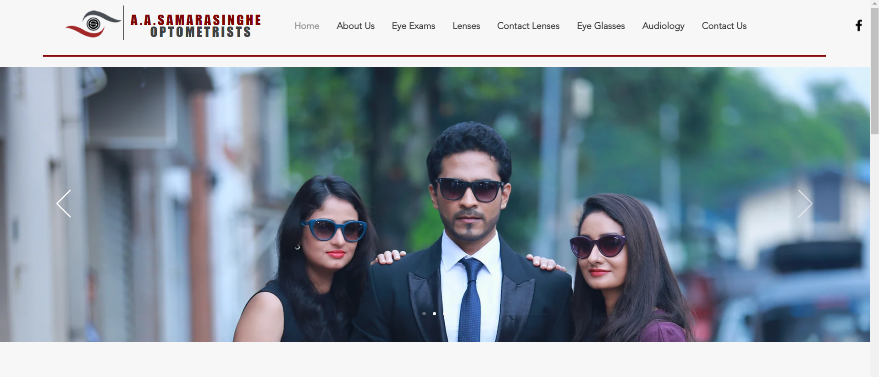
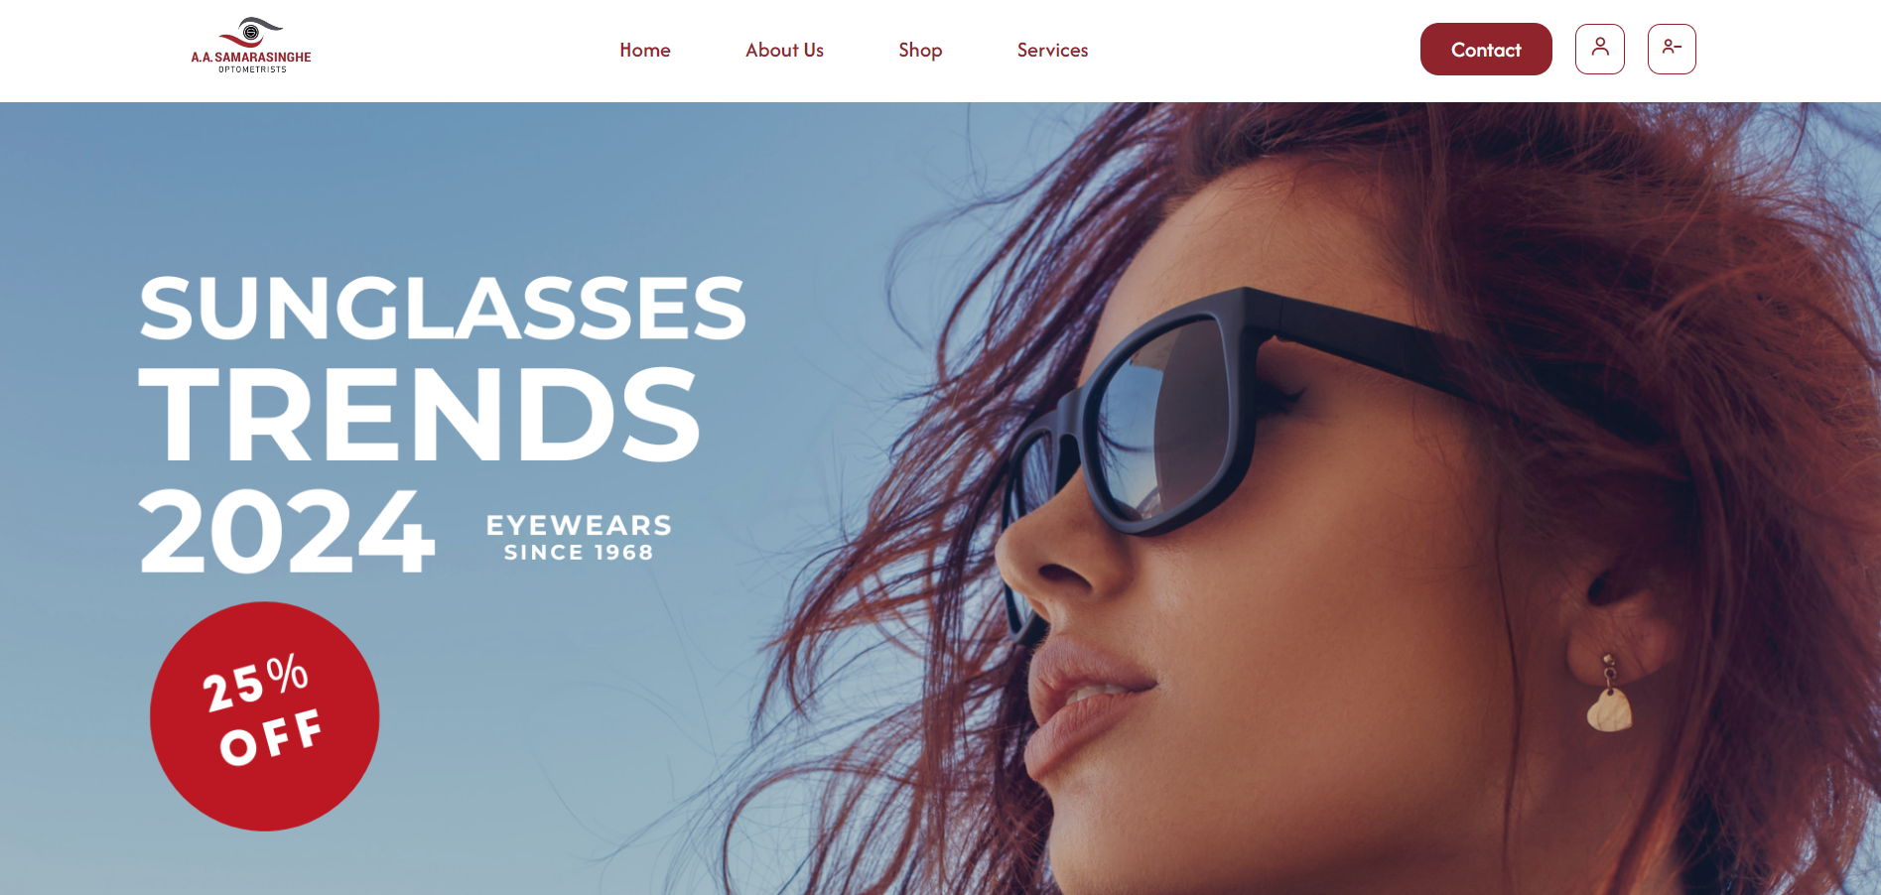
Previous
Upgraded

Slide 11
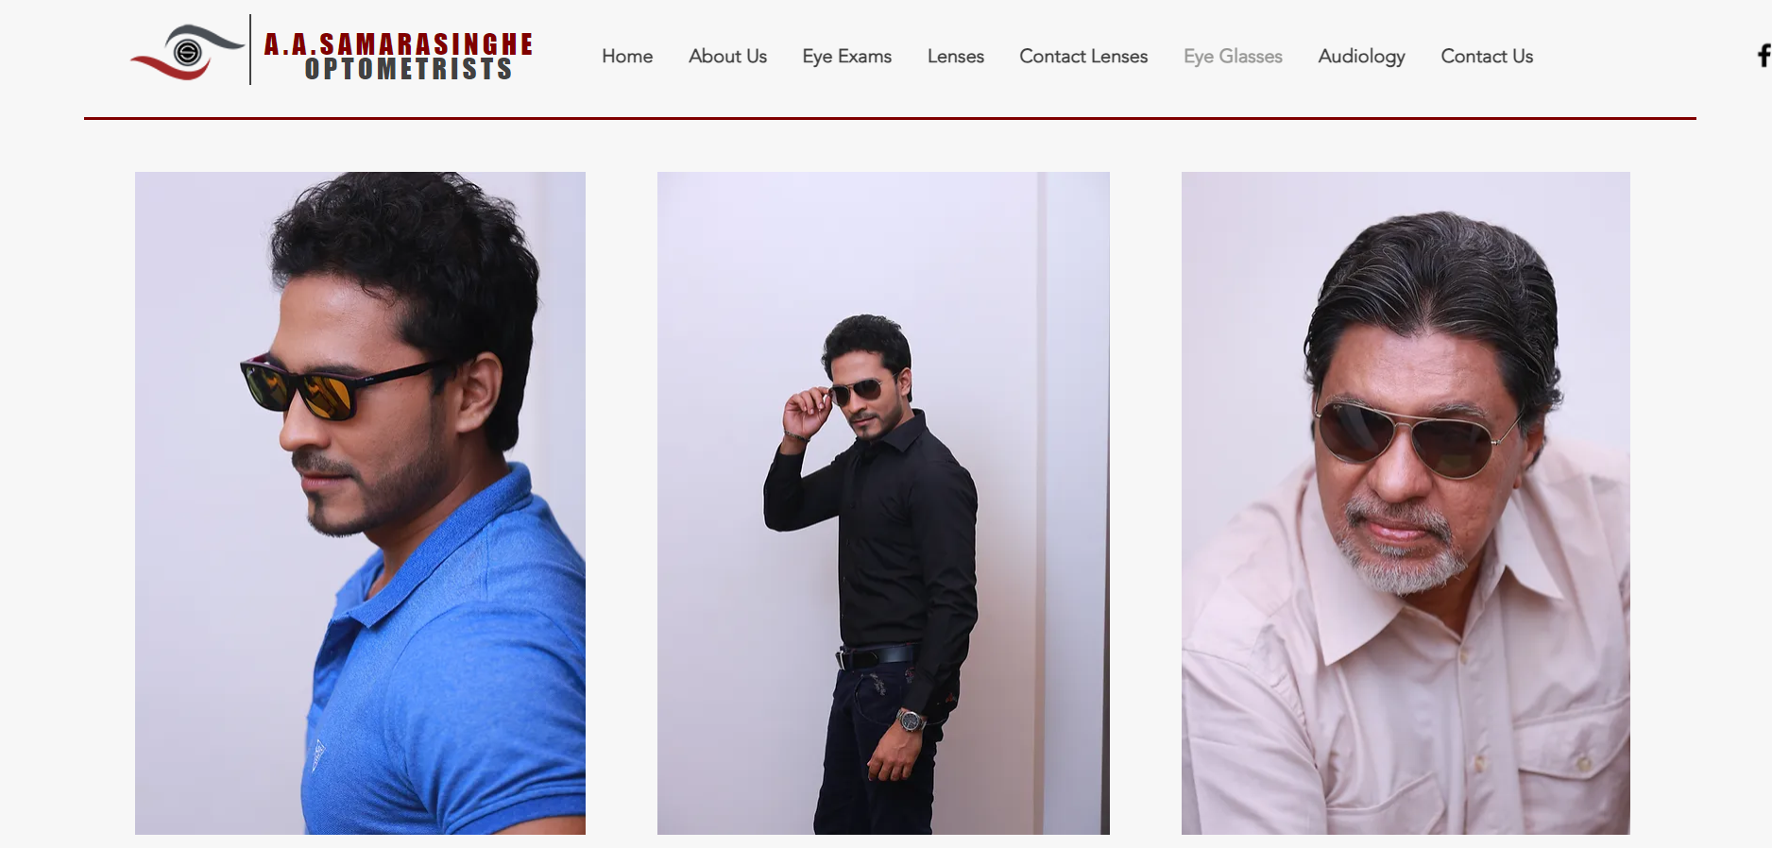
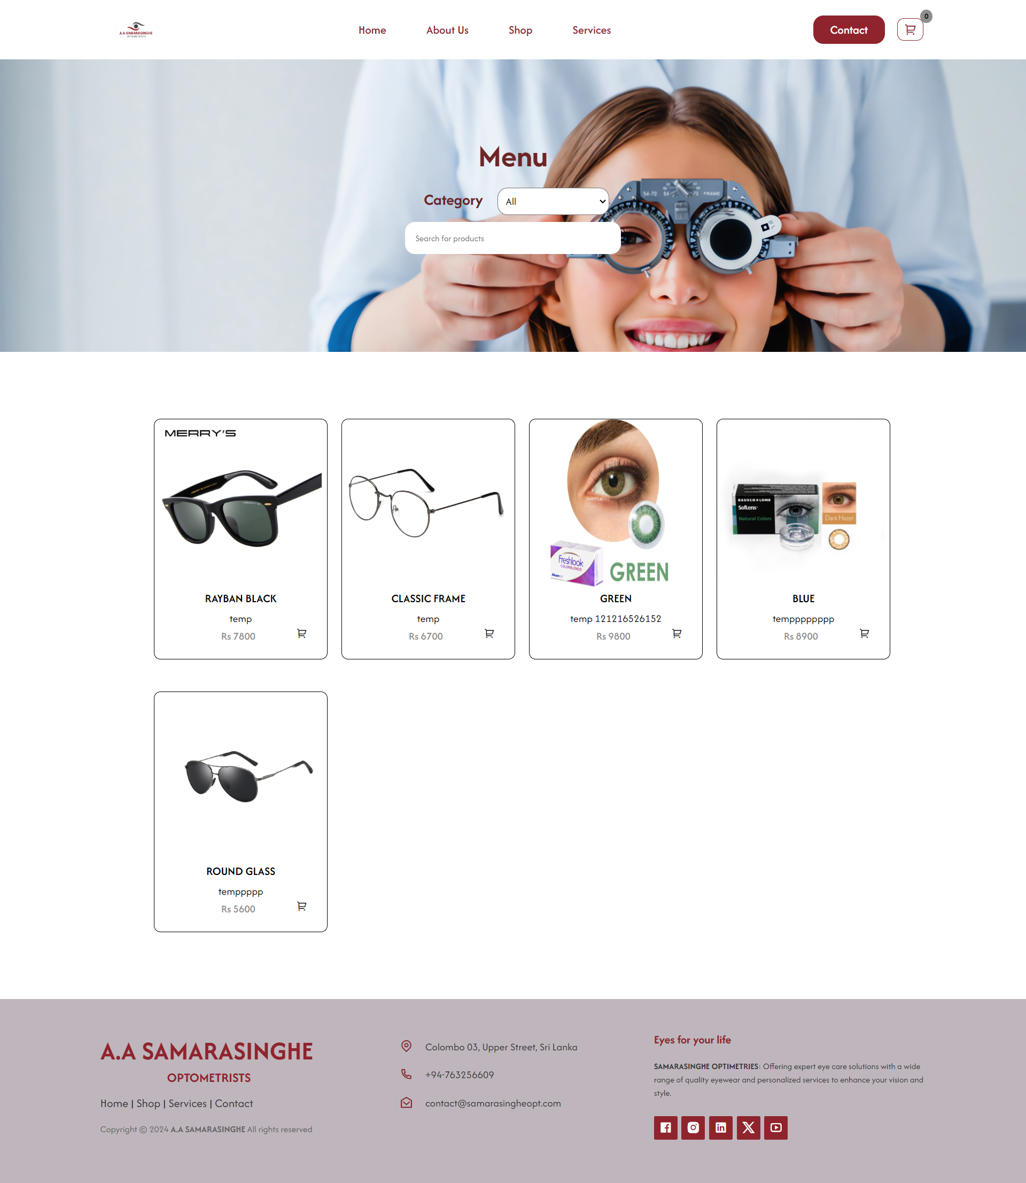
Previous
Upgraded

Slide 12
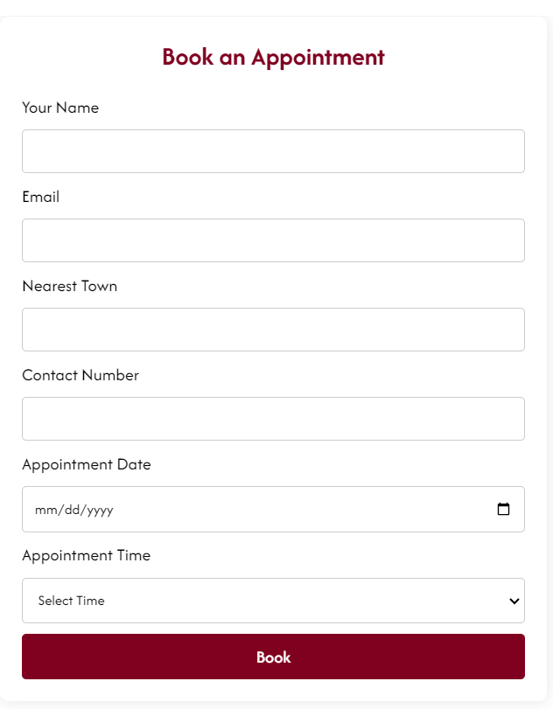
Booking Appointment

Slide 13
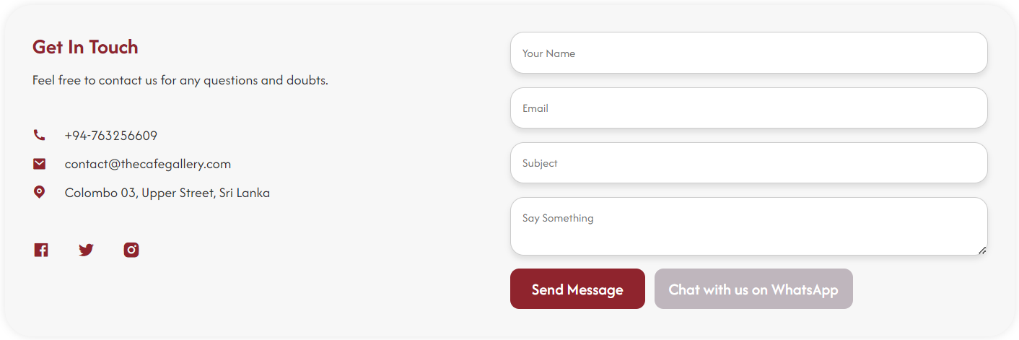
Message with Admins

Slide 14

Conclusion
The project to upgrade Samarasinghe Optica’s website by implementing an online store is both technically and financially feasible, offering significant benefits for customers as well as the company. It aims to improve customer interaction, expand market, and interact with the business more easily, and effectively. Overall, this upgrade is essential for maintaining a competitive edge in the optical industry in Sri Lanka.

